Slide 1
Final project
Predicting Conversion based on Search Attributes for a Travel Site
-- Shivendra Kishor (DAT-SF-40)

Slide 2
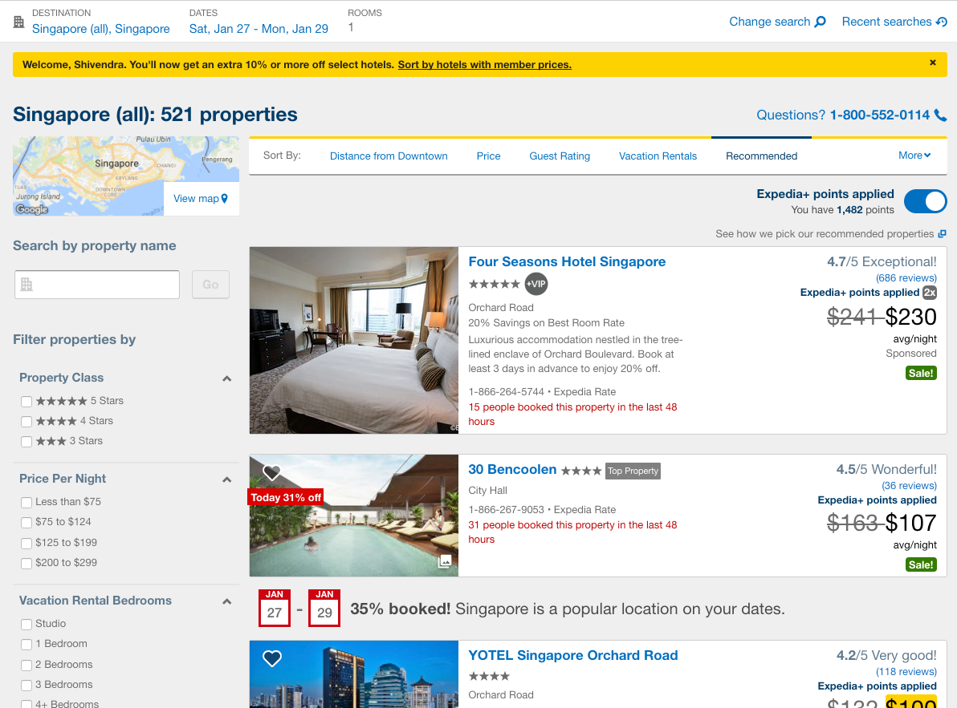
Hypothesis:
Predicting a conversion of a search using search parameters available on the travel website OR
How likely a customer is going to book an hotel based on his search parameters from his/her search session attributes

Slide 3
Data exploration: What Type of data we have

Slide 4
Data exploration: Characteristics of a dataset
Users are searching more on Desktop on Expedia site compare to Mobile
Average length of stay is higher for Continent 4

Slide 5
Data exploration: Characteristics of a dataset
Most of the users made a search with 2000 miles of their search location

Slide 6
Data exploration: Characteristics of a dataset
Most preferred destinations for Customers are from Continent 2
Point of sale is High for Expedia Site from Continent 3

Slide 7
Data exploration: Characteristics of a dataset
Maximum Booking is happening Continent 2 and 6
PoS Continent 3 has High booking event

Slide 8
Data exploration: Characteristics of a dataset
Correlation :

Slide 9
Data exploration: Characteristics of a dataset
Updated Null values associated with Origin Distance attributes with Mean value
Dropped Null values for Model dataset
Kept only the data with Night Spends at Hotel >0
Kept data with Day to Travel based on search check-In date >0
Created Indicator for Weekend travel yes now
Creating Clusters using different attributes

Slide 10
Clustering: using K means Algorithm

Slide 11
Clustering: Scatter plot for clusters (Kmeans, n= 5)

Slide 12
Models
Logistic Regression (0. 0.688318722972)
Ridge Classifier (0.664997519063)
Random Forest (0.632023711055)

Slide 13
ROC Curve:

Slide 14
Thank You!!!

